Slide 1
AIML CA2
Clustering
Lim Yu Yang Ian
2201874
DAAA/FT/2A/02

Slide 2
Objectives
Clustering
Why It’s Important
Build a clustering model That will give me insights into my customers, and identify characteristics for me to improve my mall on.
Using this I need to identify a cluster I would like to work towards retaining, and some suggestions.
I can better conceptualize better products and services
Assists in framing pricing strategies
Target advertising based on customer characteristics
Increase customer personalization
Enhance customer satisfaction

Slide 3
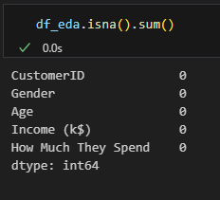
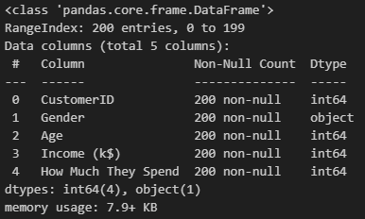
Data Observations
Null Values
Data Types
No Null values.
No Null handling needs to be done
Gender is Object type, and needs to be dealt with.

Slide 4
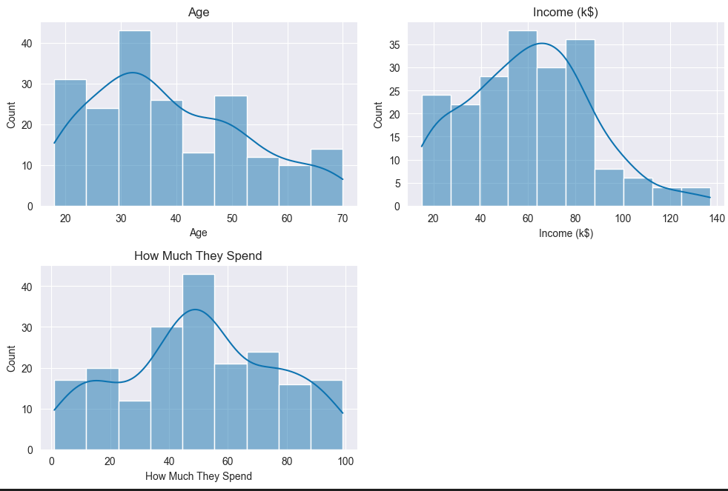
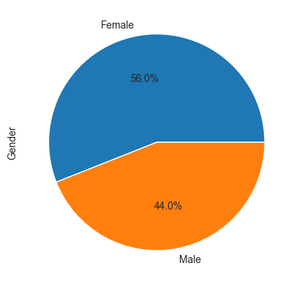
Data Observations
Age and Income are skewed to the left
Hard to tell if How Much They Spend is normally distributed.
More Females than Males

Slide 5
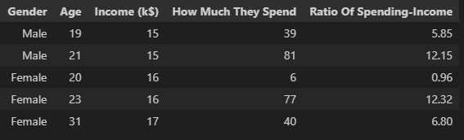
Feature Engineering
I added the feature Ratio Of Spending-Income.
It is calculated via:
How Much They Spend * Ratio Of Spending-Income / 100
Will help to capture the percentage of their income customers are willing to spend at my mall

Slide 6
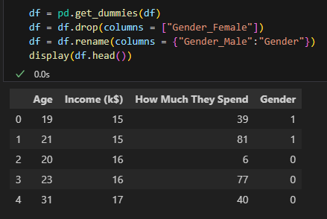
Encoding
Encoding
Gender is an Object Dtype.
As gender only has Male and Female, there are few categorical values.
Thus I use One Hot Encoding to encode my values.
This allows the model to use this data, and capture Gender in my final model.

Slide 7
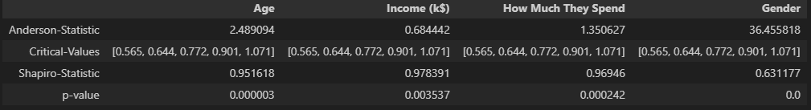
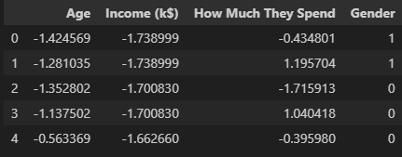
Scaling
Shapiro and Anderson Test
I used the Shapiro and Anderson Test to test for Gaussian Distribution
Min Max Scaler
Since the p-value is below 0.05, we can assume that Gaussian Distribution is not present.
Used the Min Max Scaler as it can handle non gaussian distribution datasets

Slide 8
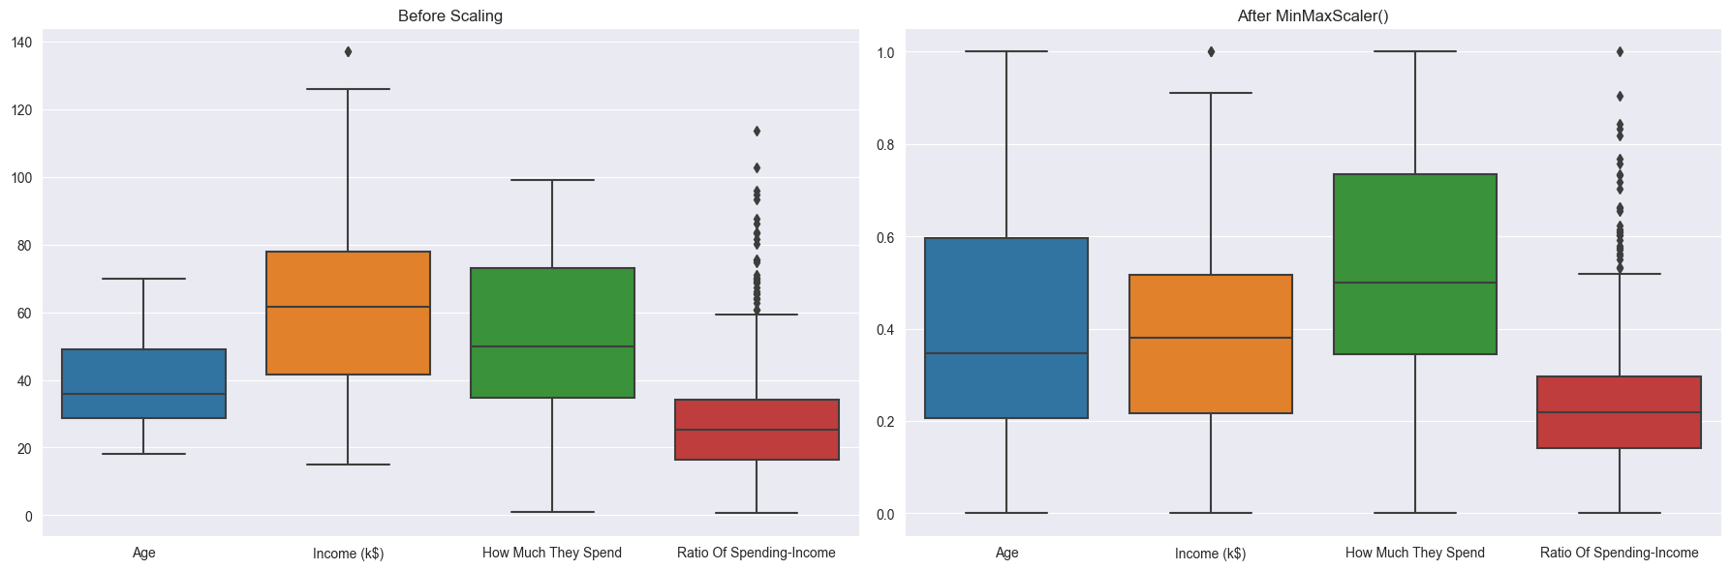
Scaling
All values are between 0 and 1 now after scaling.
This makes it easier for the model to compute, and makes the model overall better.

Slide 9
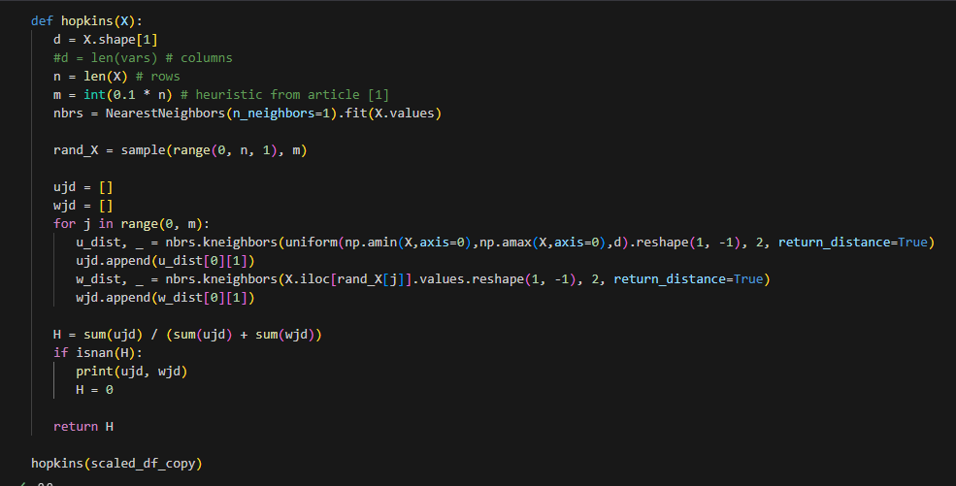

Hopkins Clustering Tendency
The Hopkins Clustering Tendency helps to determine the clustering tendencies of the data.
The higher the score, the more likely the clusters are to be meaningful, and give better insights.
I received a score of 0.856. This is a very good score, and will give meaningful clusters.

Slide 10
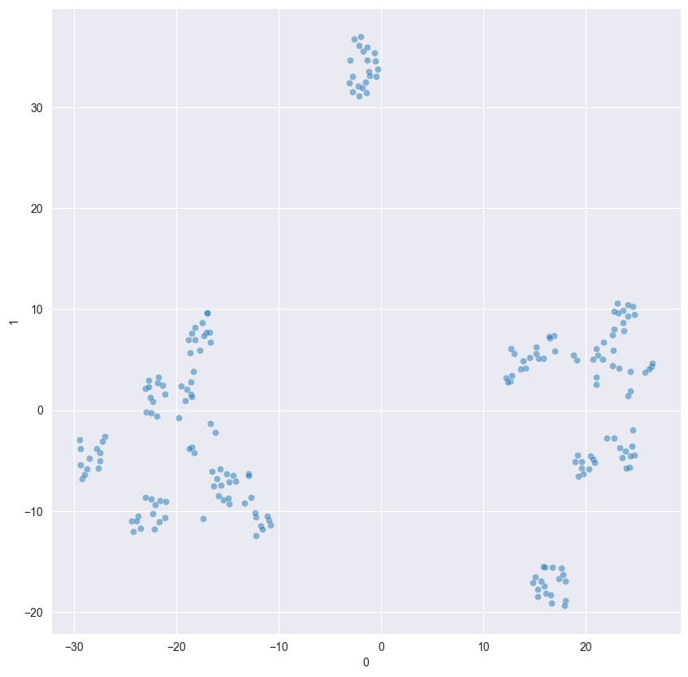
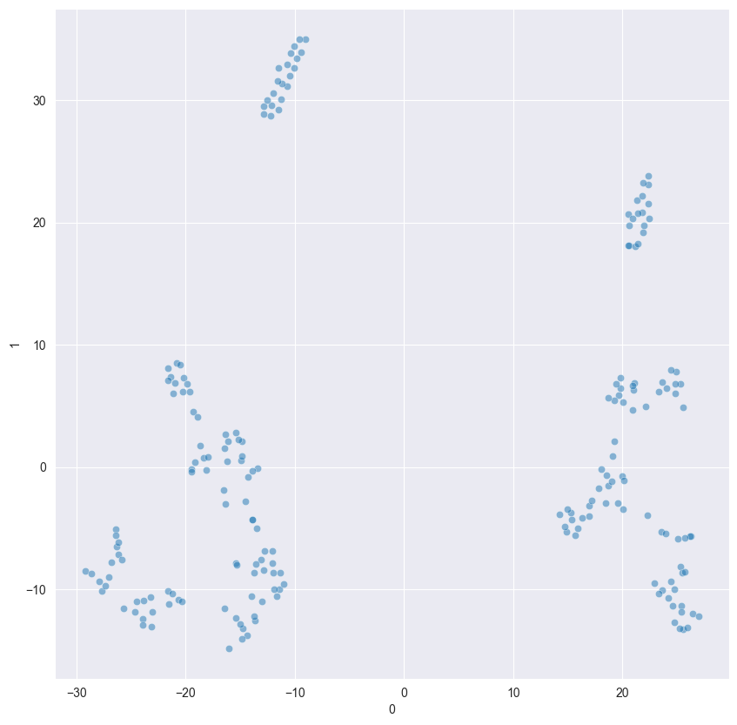
Dimension Reduction with TSNE & Gower
TSNE helps to reduce my dimensions to 2, anf Gower helps to enhance my model
After TSNE
After TSNE & Gower

Slide 11
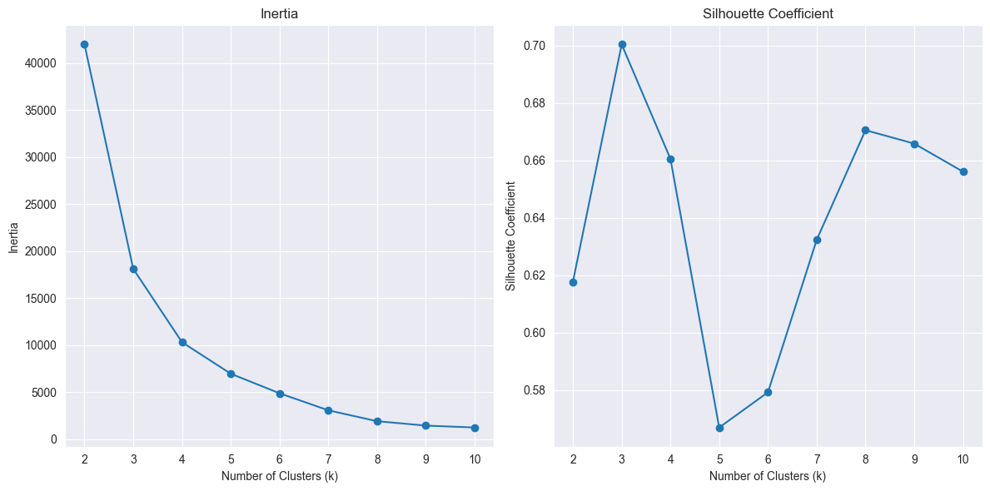

Silhouette & Inertia
Silhouette Coefficient peaks at 3 and 8
8 is chosen as it has a lower Inertia score despite having a higher Silhouette score.
I will run all models (that accept n_clusters) with the number of clusters as 8

Slide 12
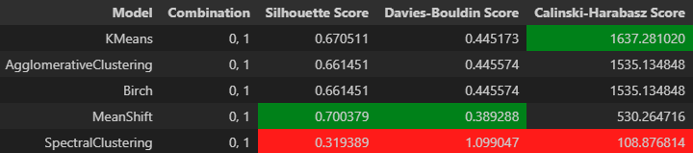
Model Evaluation
I plotted all the models out below, and gathered their scores.
Observations:
Spectral Clustering has the worse scores on all 3 metrics
Mean Shift has the best Silhouette and Davies Bouldin Score
KMeans has the best calinkski harabasz score
I will continue with the top 3 performing models:
1. Mean Shift
2. KMeans
3. Agglomerative Clustering

Slide 13
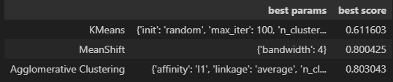
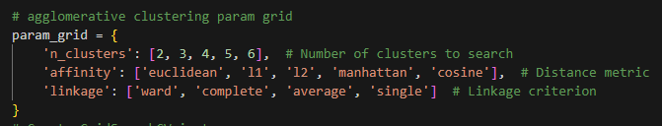
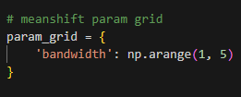
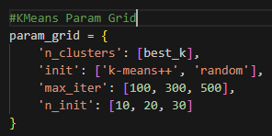
Hyper Parameter Tuning
I tuned the 3 models, and returned the best score based on Silhouette.
The hyper parameters are below.
Mean Shift came up on top

Slide 14
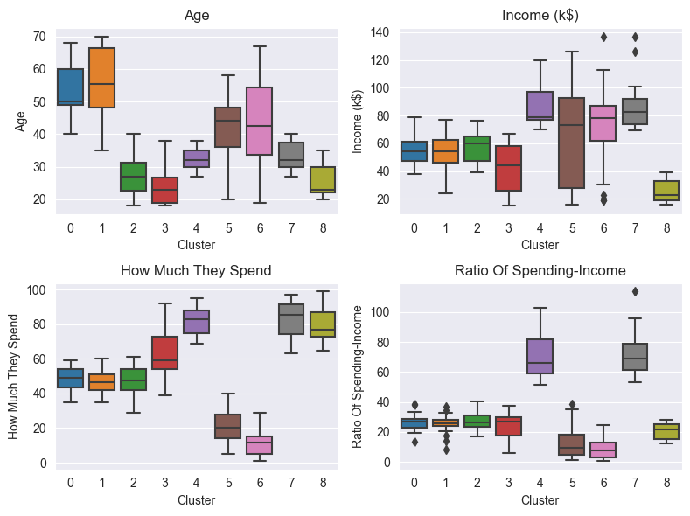
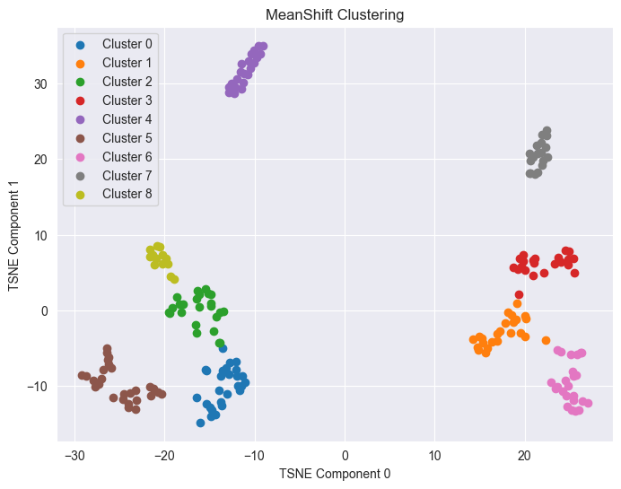
Data Visualization
Cluster Interpretation
0. Female Ageing middle spenders
1. Male Ageing middle spenders
2. Female Youth middle spenders
3. Male Youth Impulsive Spenders
4. Female Middle Aged High Ballers
5. Female Thrifts
6. Male Thrifts
7. Male Middle Aged High Ballers
8. Female Youth Impulsive Spenders:

Slide 15
Conclusion
Loyal Customers
Clusters 4 and 7 have very high Incomes and Spending.
There are already very loyal customers.
They are middle aged, and could eventually bring their children.
Discounts, or sales can be done to reward them, retaining them as loyal customers.
Potential
Cluster 2 has middle Income and Spending
They are willing to spend some money in the mall.
They are still relatively young, and can grow to become loyal consumers.
Discounts, or sales can be done to attract them.
More budget options can be opened up for them.
A wider range of products catering to Females can be opened up.

